Slide 1
The Popper Convention: Practical Reproducibility
Ivo Jimenez, Michael Sevilla, Noah Watkins, Carlos Maltzahn (UC Santa Cruz)
Jay Lofstead (SNL)
Kathryn Mohror, Adam Moody (LLNL)
Andrea Arpaci-Dusseau, Remzi Arpaci-Dusseau (UW-M)

Slide 2
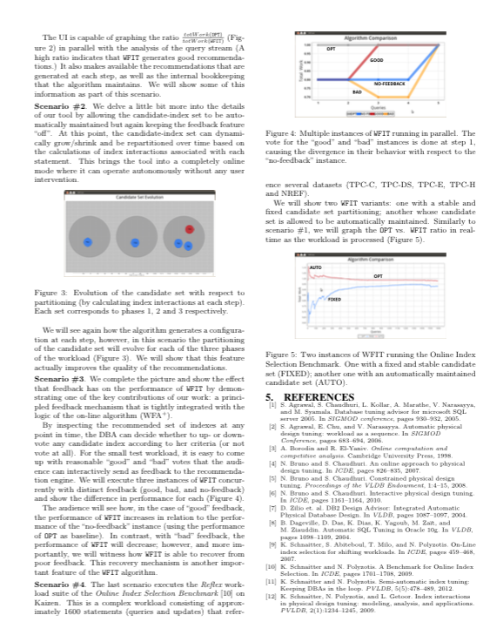
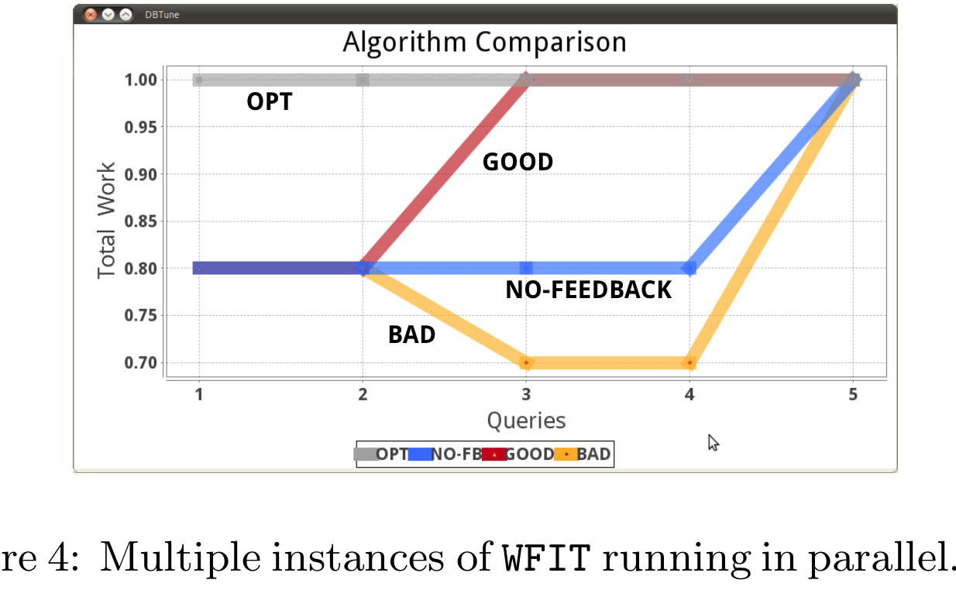
Problem of Reproducibility in Computation and Data Exploration
What compiler was used?
Which compilation flags?
How was subsystem X configured?
How does the workload look like?
How would results look on dataset Y?
And if I run on hardware platform Z?
… WHY??
Notes:
Data: How does the workload really look like? What other properties of the workload can I infer?
We wonder… mmm... I can get access to the source code of the system, but mostrly anything else that the experiment depends on is missing
I whish I could have the “source code” of the experiment, along with any workloads and datasets, analysis and so on…. along with the history of how the experiment evolved over time and the rationale (WHY) behind the decisions made.
Note that this is different to having the source-code of the system under study . This is usually done, but going from source-code to executing the experiment is a really long, time-consuming process (e.g. see

Slide 3
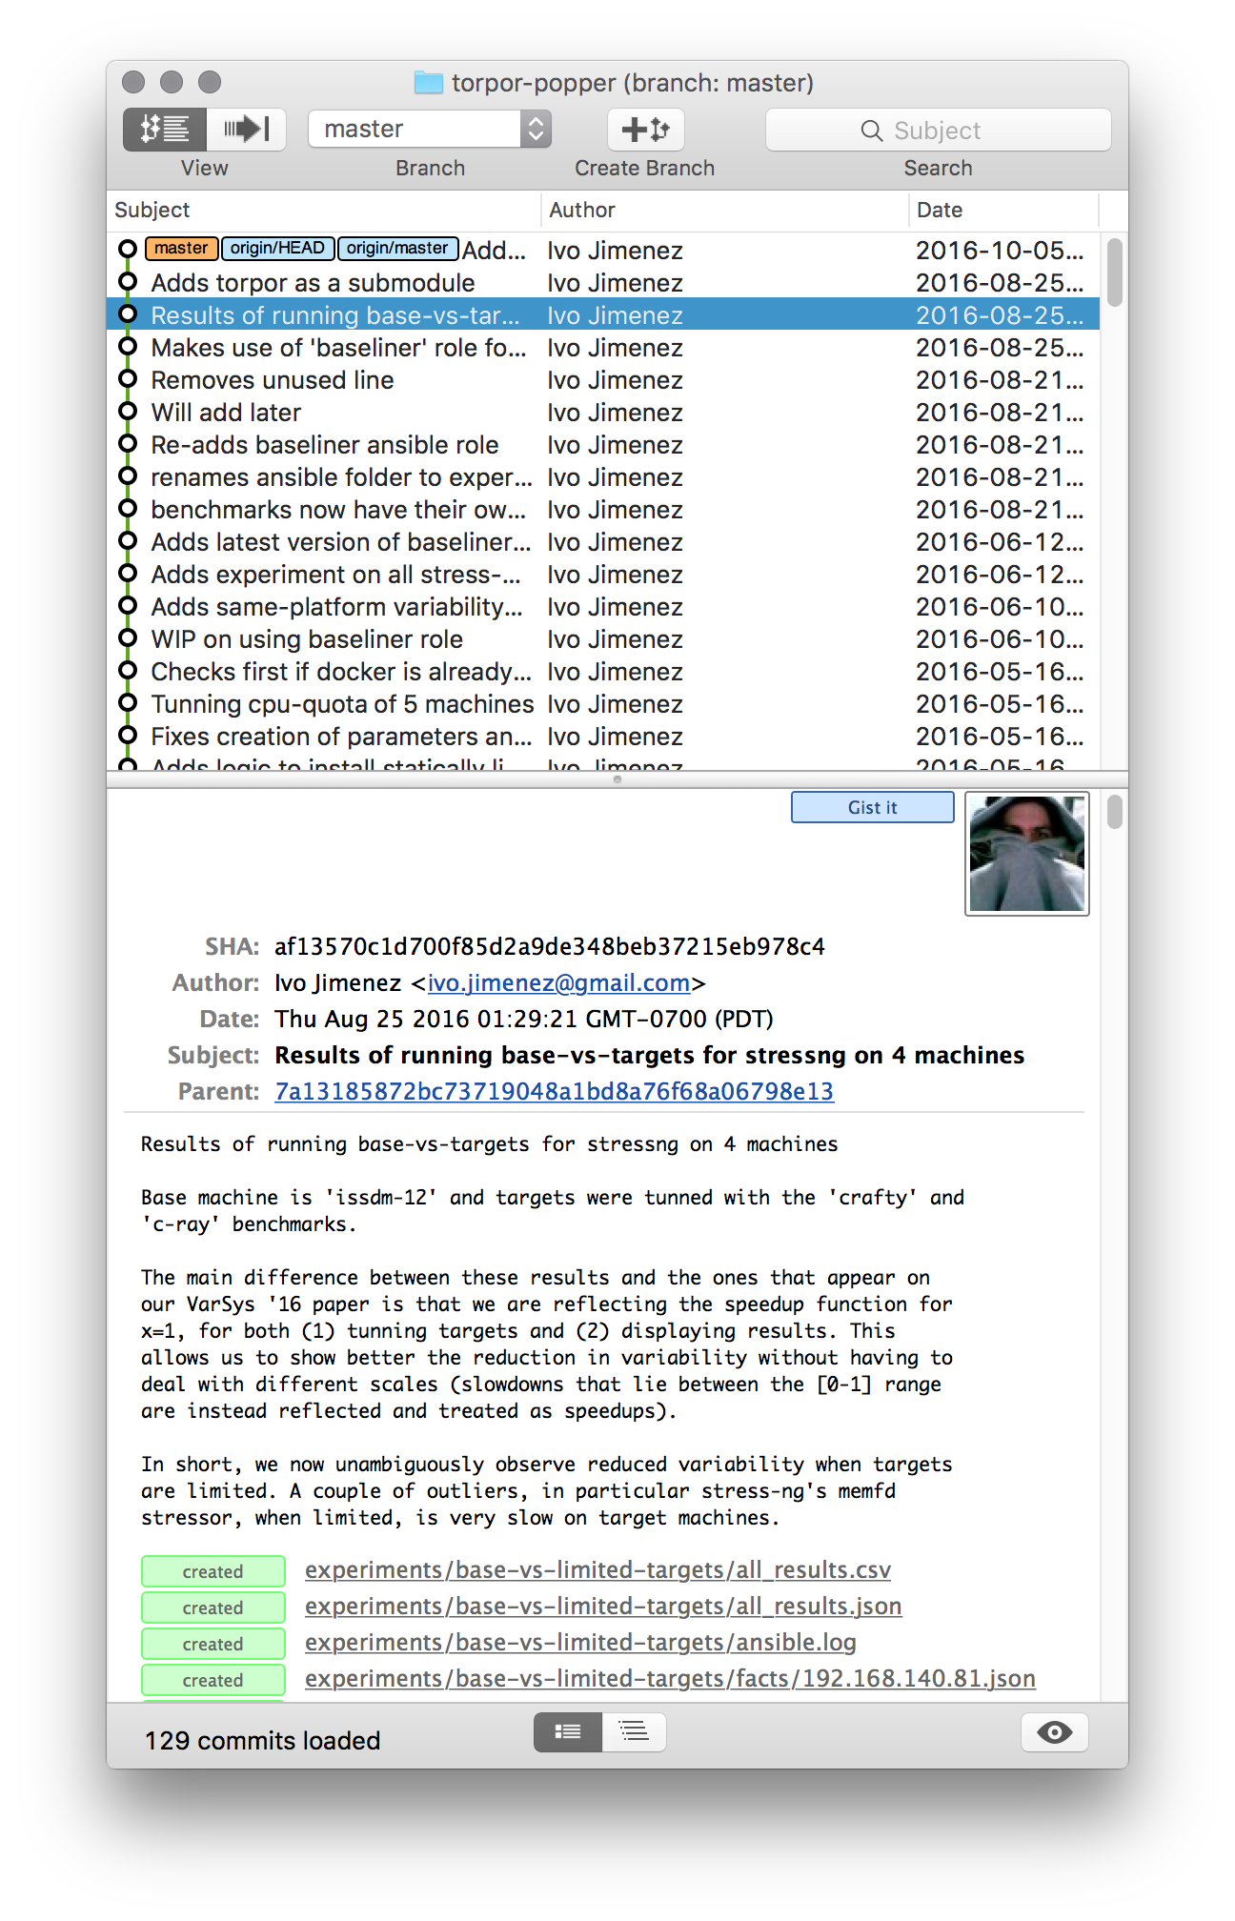
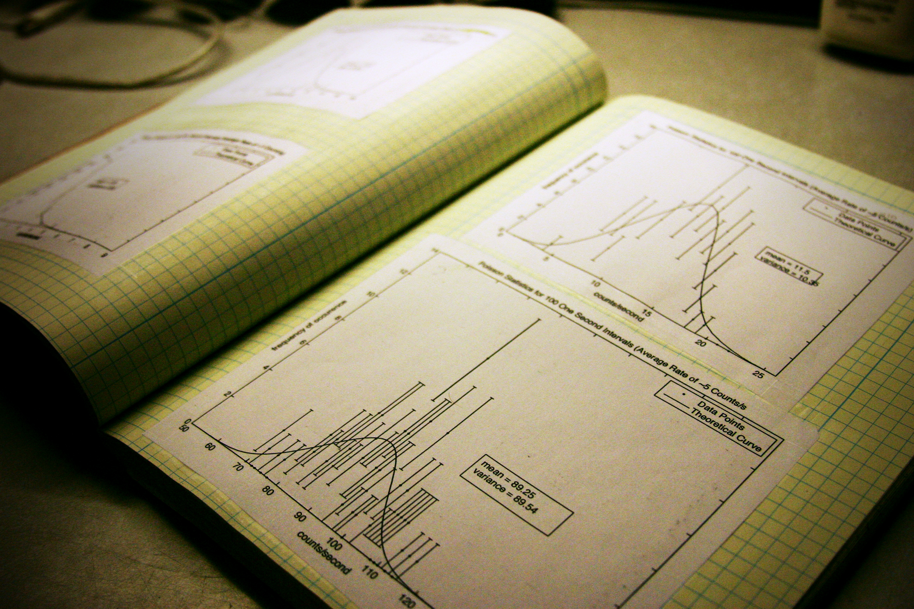
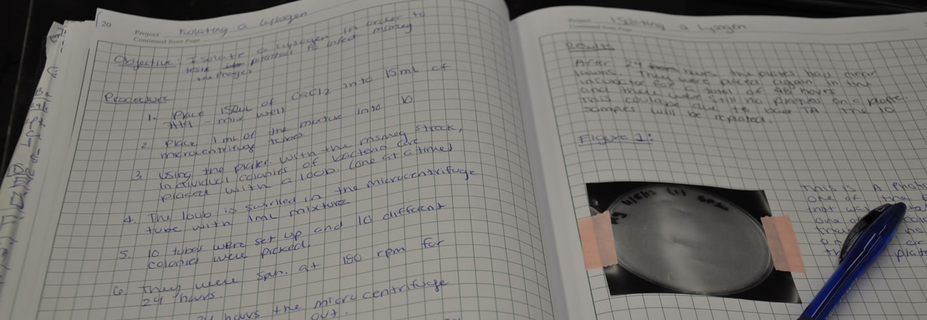
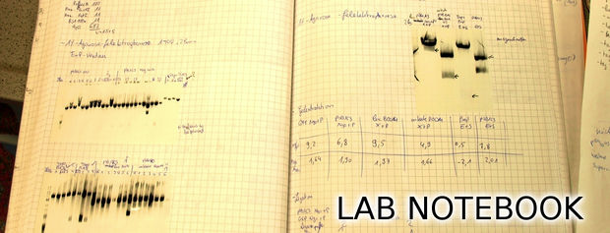
Lab Notebook
Notes:
In some sense, I want the equivalent of what researchers in experimental sciences have: the lab notebook to document my experiment.
If our experiments are mostly code, then one way to look at this is as if we had the source code (of the EXPERIMENT) and a log (the commit log) detailing the evolution of the experiment over time

Slide 4
Analogies with DevOps Practice
Scientific exploration | Software project
Experiment code | Source code
Input data | Test examples
Analysis / visualization | Test analysis
Validation | CI / Regression testing
Manuscript / note book | Documentation / reports
Key Idea: manage a scientific exploration like software projects
Notes:
Software engineers deal with reproducibility all the time: “reproduce bug on version x with parameters y using data z”
Naturally, they’ve developed sophisticated techniques and tools to deal with this. Why don’t we leverage this?
Many open source, mature tools available for us so that we can treat a scientific exploration as a software project
But how do we structure a project, from the point of view of ?

Slide 5
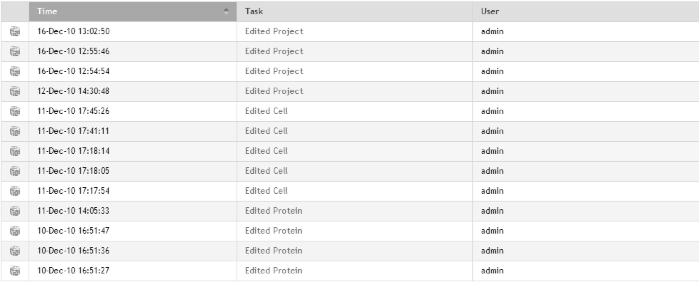
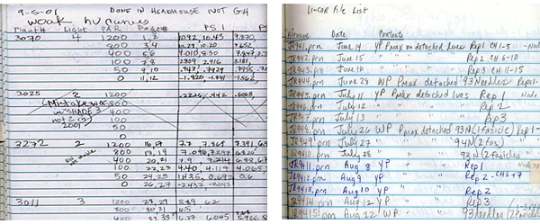
Common Experimentation Workflow
Code
Package
Execute
Output Data
Analyze/
Visualize
Manuscript
Input Data
Notes:
80-20 rule: we argue that almost everybody working on a research project with a computational component in it follows this workflow. Although there are some that don’t fit this description we focus on this one since it’s the majority
Similarity to ctuning’s (Grigori Fursin) artifact evaluation structure
Reasons to iterate:
Fix a bug in the code
Change parameters of the experiment
Run on other type of data
The equivalent of a lab notebook is documenting an experiment’s evolution
Either manual or electronic
Documents changes to the workflow
this is almost never done or done in a very ad-hoc way, e.g. a text file with notes (with date markers)
E.g. : I added a new parameter, new technique, new baseline, etc…

Slide 6
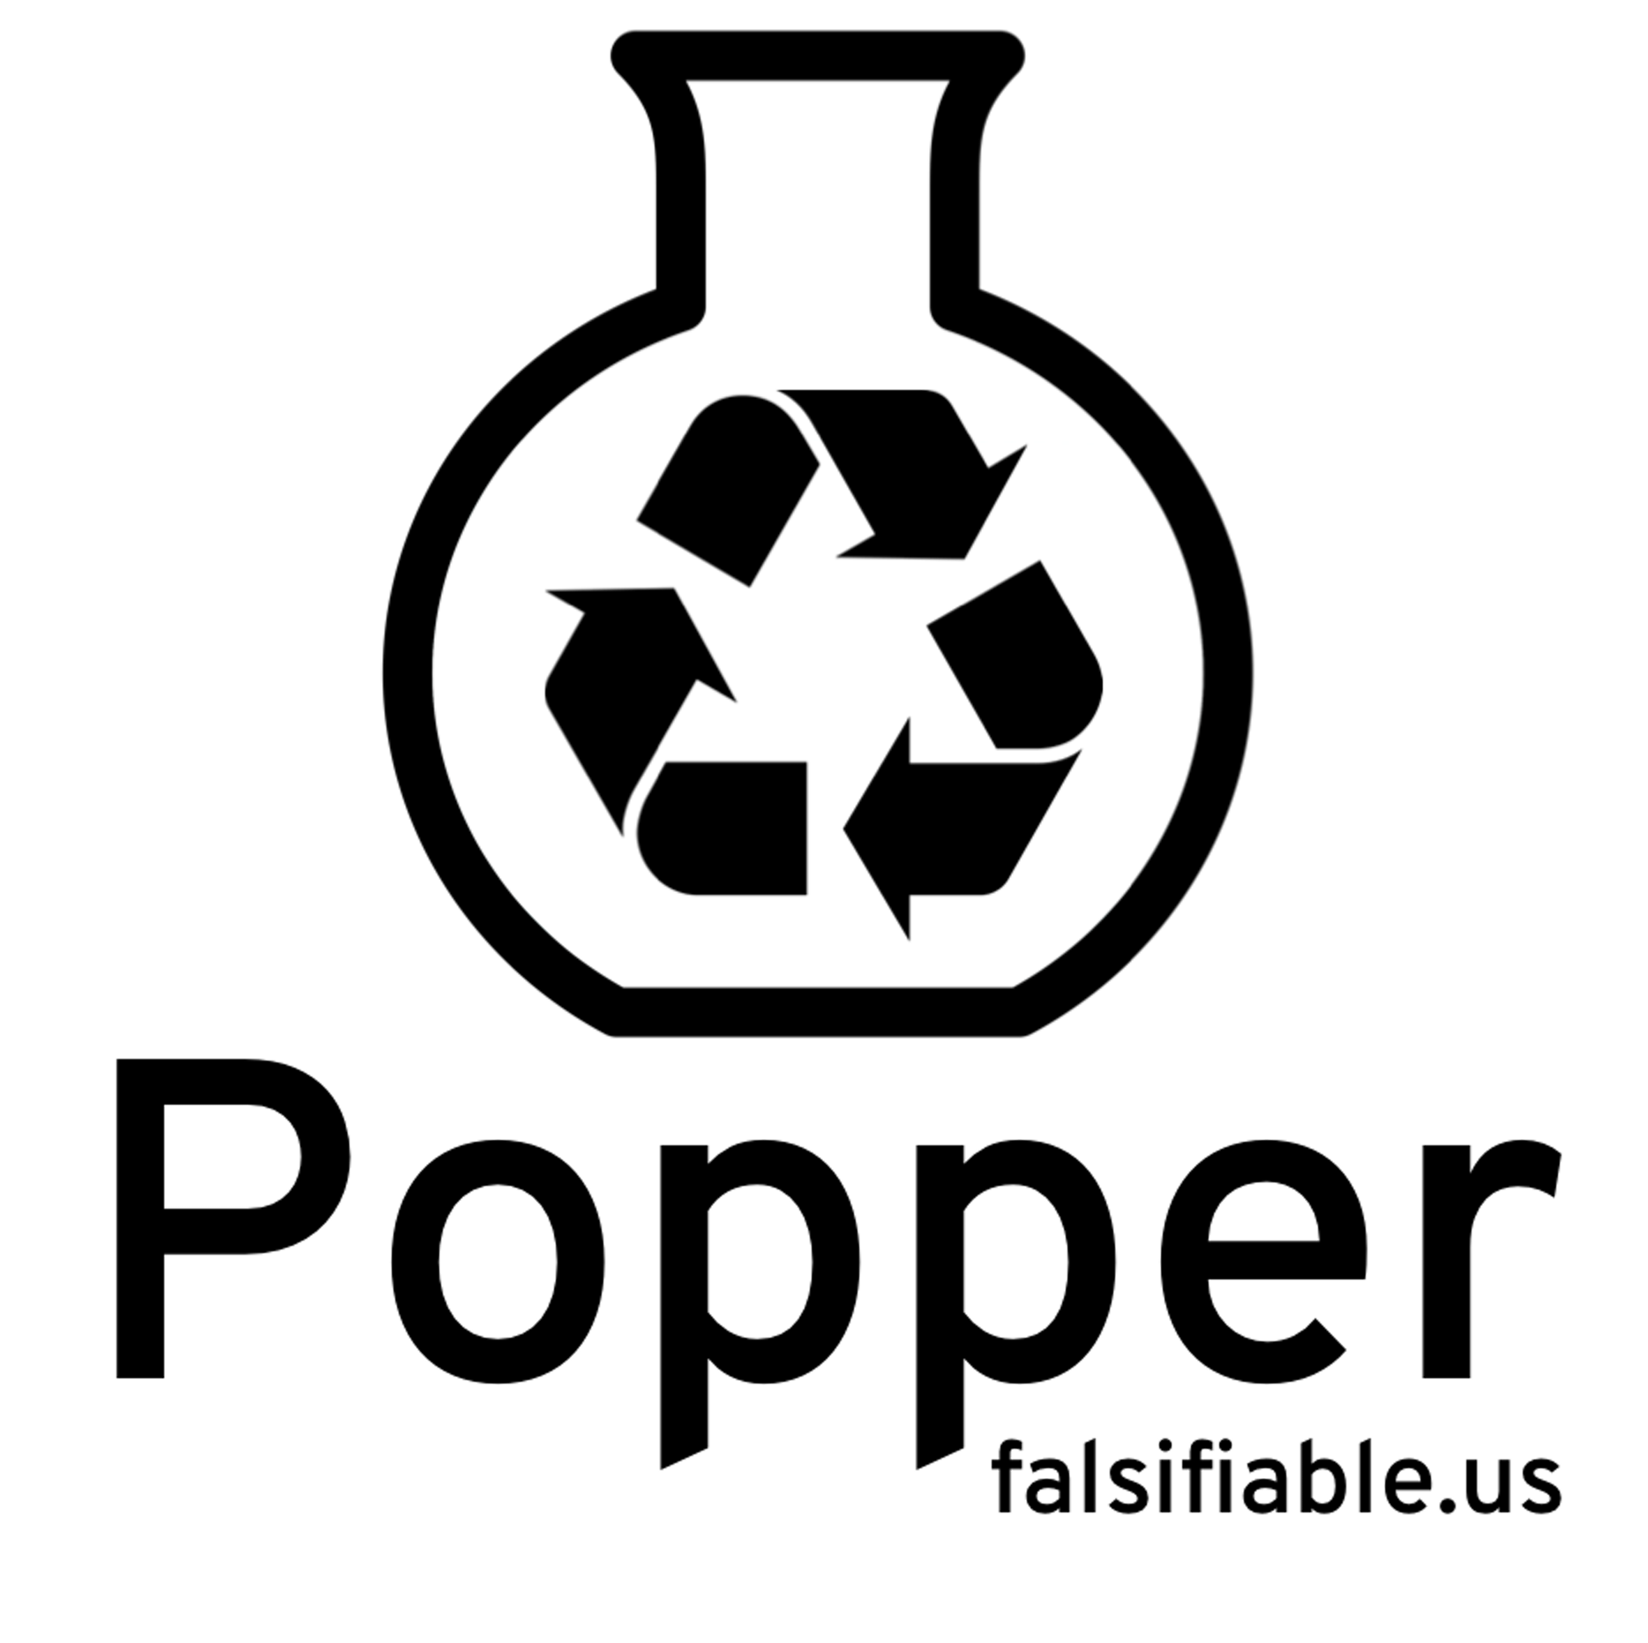












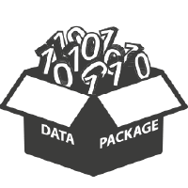






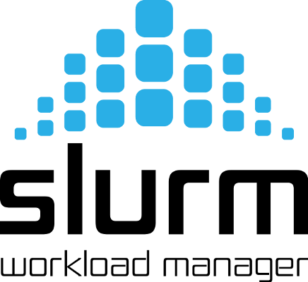
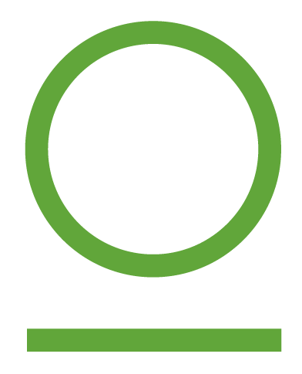



Code
Package
Execute
Output Data
Analyze/
Visualize
Manuscript
Input Data
Notes:
Popper: the insight that DevOps practice can be repurposed for research, so that we treat articles as OSS projects
We address all of our desiderata:
Reproducible from the beginning: since we’re scripting everything, everything is automated always (there are never manual steps). To reduce the entry barrier, we have a popper-cli tool to make it easier to bootstrap a project, so that there’s more time saved (and less effort) when creating a paper (popper) repo.
Make scientist more productive: no need to remember things or waste time finding ways to organize stuff (the convention takes care of this mental burden). Once you become knowledgeable on the tools, you’re very efficient
Captures end-to-end workflow: if resources are available, we can execute the entire pipeline. Additionally, the git commit log becomes the lab notebook, thus we have the entire history of the experiment changes
Make use of existing tools: we’re just wrapping everything in a reproducible container, in a tool-agnostic way
Amenable to extension: fork a project, make changes, publish (we make the phrase “standing on the shoulders of giants” a reality). Also, by having curated experiment templates, people collectively benefit.
Logos (left-to-right, top-to-bottom):
code: git, mercurial, subversion
package: docker, vagrant (virtualization); spack, nix (modern package managers)
Input/output data: git-lfs, datapackages, artifactory (closed source), apache archiva (open source)
Run: Ansible, Puppet, Chef, Salt, Slurm, …
Analysis/visualization: jupyter, paraview, travisCI, jenkins
Manuscript: mardkown, latex
Change tracking (outer box): gitlab, bitbucket, github

Slide 7
Pick a DevOps tool for each stage.
Each component of experimentation workflow.
Put all associated scripts in version control.
Make experiment self-contained.
Document changes as experiment evolves.
In the form of commits.
Notes:
In terms of an imperative list of steps, this is what it means to follow the Popper convention (or methodology)
DevOps tool doesn’t have to be OSS, as long as the scripts are available (e.g. .m files for matlab)

Slide 8
Popper-compliant Experiments
An experiment is Popper-compliant if all of the following is available (self-contained) and running:
Experiment code
Orchestration
Data dependencies
Parameterization
Results
Validation
Notes:
In other words, we “popperize” an experiment if we make all of the above self-contained

Slide 9
Popper-CLI
$ cd mypaper-repo
$ popper init
-- Initialized Popper project mypaper-repo
$ popper experiment list
-- available templates ---------------
ceph-rados proteustm mpip adam sirius comd-openmp
cloverleaf gassyfs zlog bww unum-py cuddn-deeplrn
spark-bench torpor malacology genevo mantle rita-idx
hadoop-yarn kubsched alg-encycl macrob dadvisor obfuscdata
$ popper experiment add gassyfs
-- Added gassyfs experiment to mypaper-repo
$ popper experiment init mynewexp
-- Initialized mynewexp experiment in mypaper-repo
Notes:
We provide a CLI tool that provides curated experiment templates. It also helps to bootstrap experiments that are Popper-compliant (experiment scaffolding feature).

Slide 11
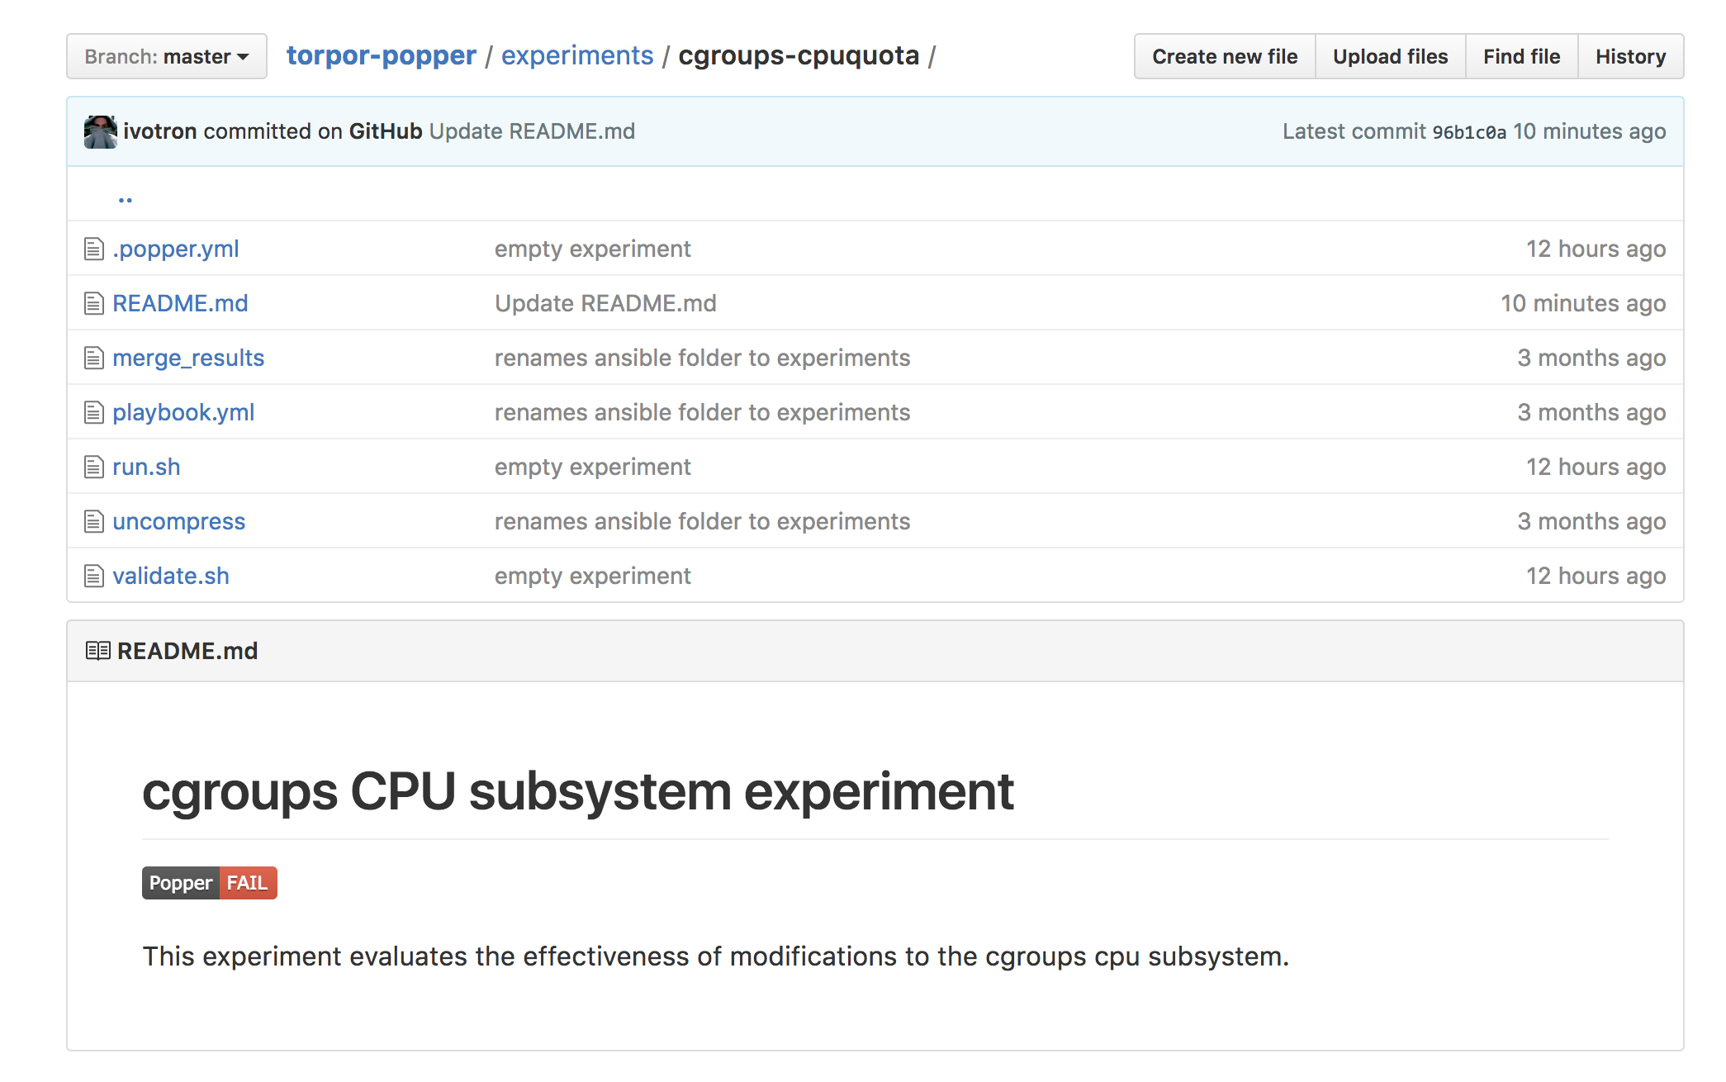


Automated Validation
Notes:
We also maintain a RESTful service at popper-status.falsifiable.us that makes it easier to track the status of an experiment . This also serves badges that can be used in README files of an experiment to display the current status of an experiment.

Slide 12
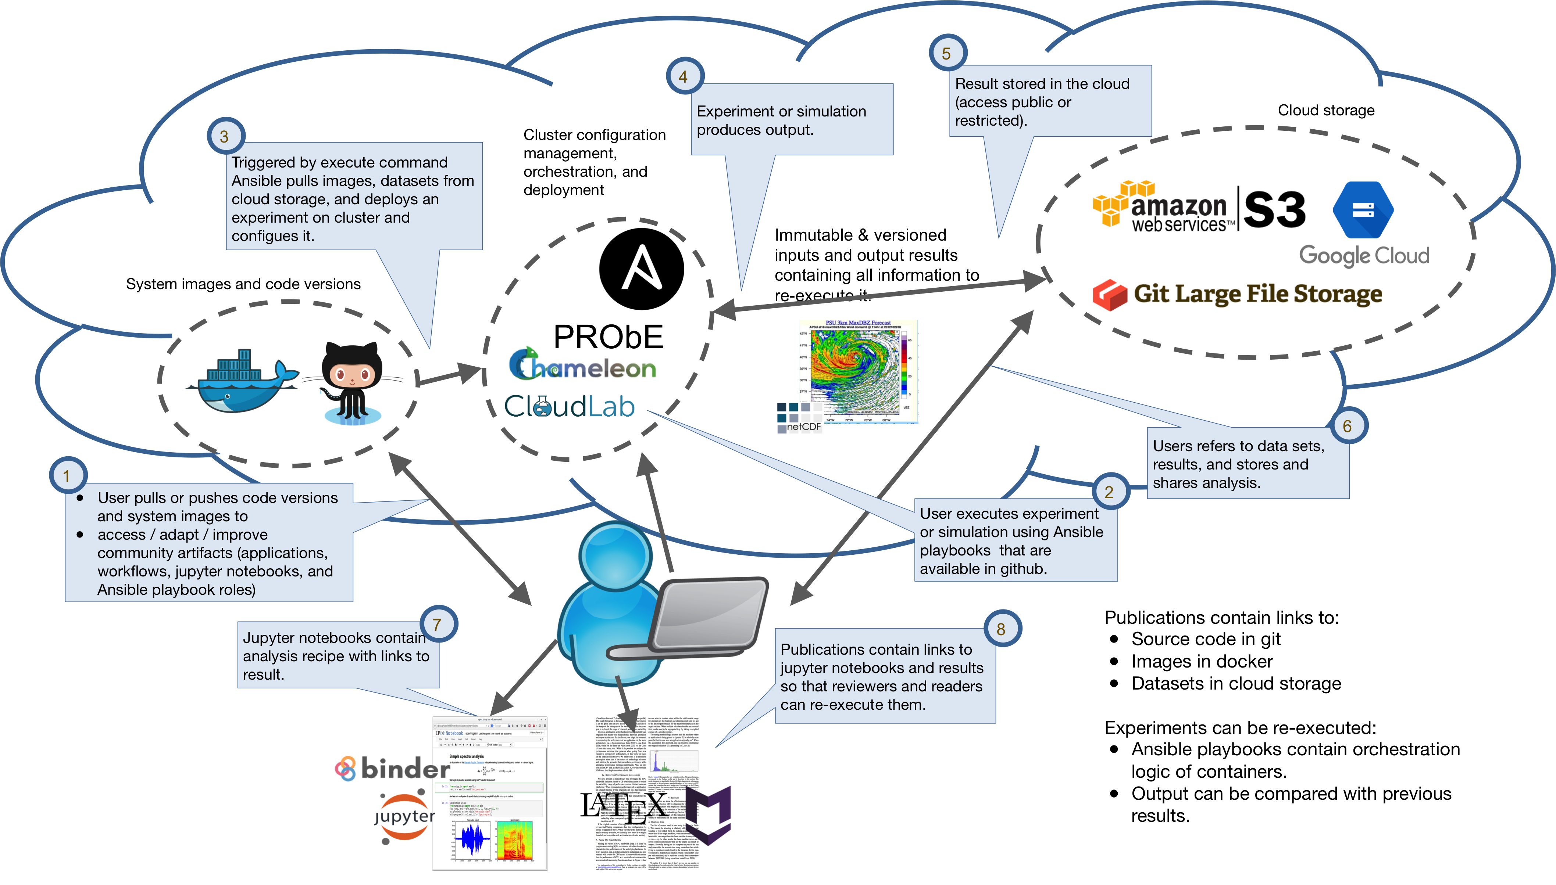
Reviewer/Reader Workflow
Notes:
This shows the workflow that someone repeating a Popperized experiment follows, for a particular toolchain (docker, ansible, Jupyter, LATeX and S3).
We leverage shared resources (NSF-sponsored Chameleon/Cloudlab and DOE’s PRObE) to re-execute experiments.

Slide 13
Other Use Cases
Parallel Algorithms Encyclopedia
ctuning extended artifact description
HPC Proxy applications (mini-apps)
Elsevier’s 2011 executable paper challenge

Slide 14
Communities
Numerical weather prediction as part of the Big Weather Web (bigweatherweb.org)
Distributed Systems (UCSC / UW Madison)
Game design as part of the generative methods effort at the (UCSC Augmented Design Lab)
HPC at LLNL and Sandia
Genomics at UCSC

